Slide 1
Field Expedient Multi-Band HF Antennas
Daniel V. Wolff, Jr., US Army MARS

Slide 2
Preface
This is a collection of some of the more popular, classic multi-band HF antenna types that have been used in some form or similar configuration since the early days of radio. There are many more variations on the antenna themes presented here. So, I encourage you to do more research on each type. There are generations of experts to guide you and feed your thirst for knowledge.
These antennas are relatively easily employed and in most cases, deployable using a minimal amount of material or equipment to achieve an efficient radiating antenna. Thus, these antennas are well suited for field and portable use. The material to build these antennas can be obtained through commercial vendors or the military supply system. Likewise, commercial or military versions and variations of these are also available.
I’ve used each of these antenna types with tremendous success throughout my career in the military (USAF and Air National Guard), my membership in MARS, and also as an Amateur Radio operator. They also represent some of my personal favorites. Try each antenna type and enjoy the wonder of radio.

Slide 3
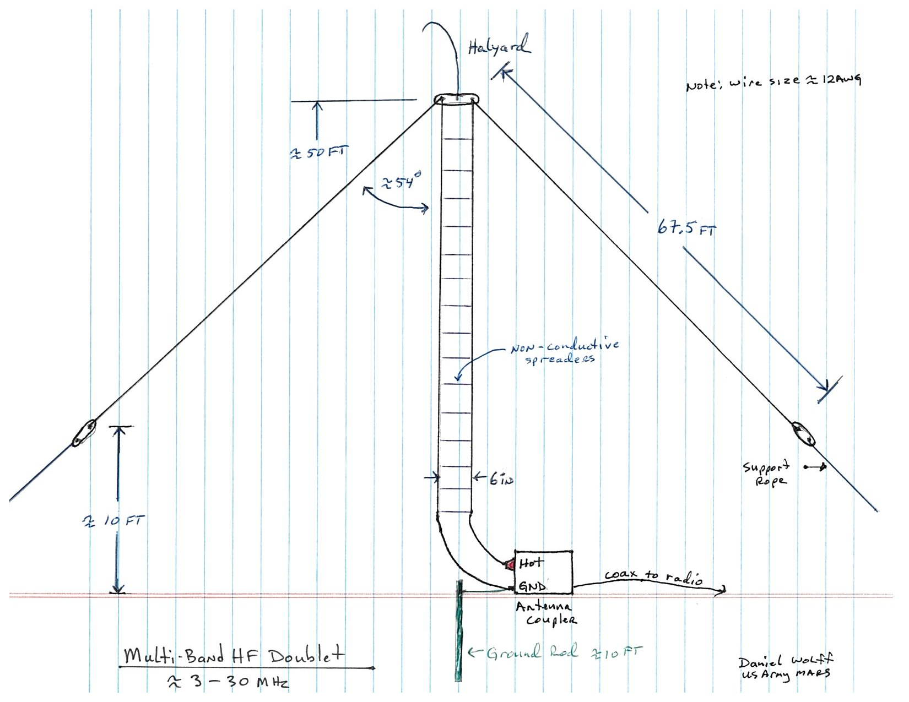

Slide 4
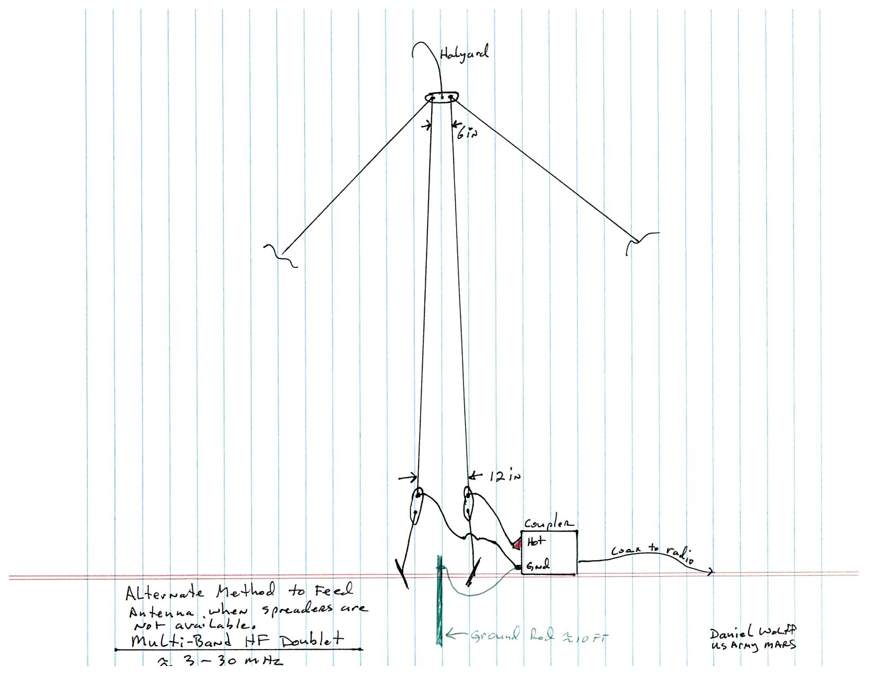

Slide 5
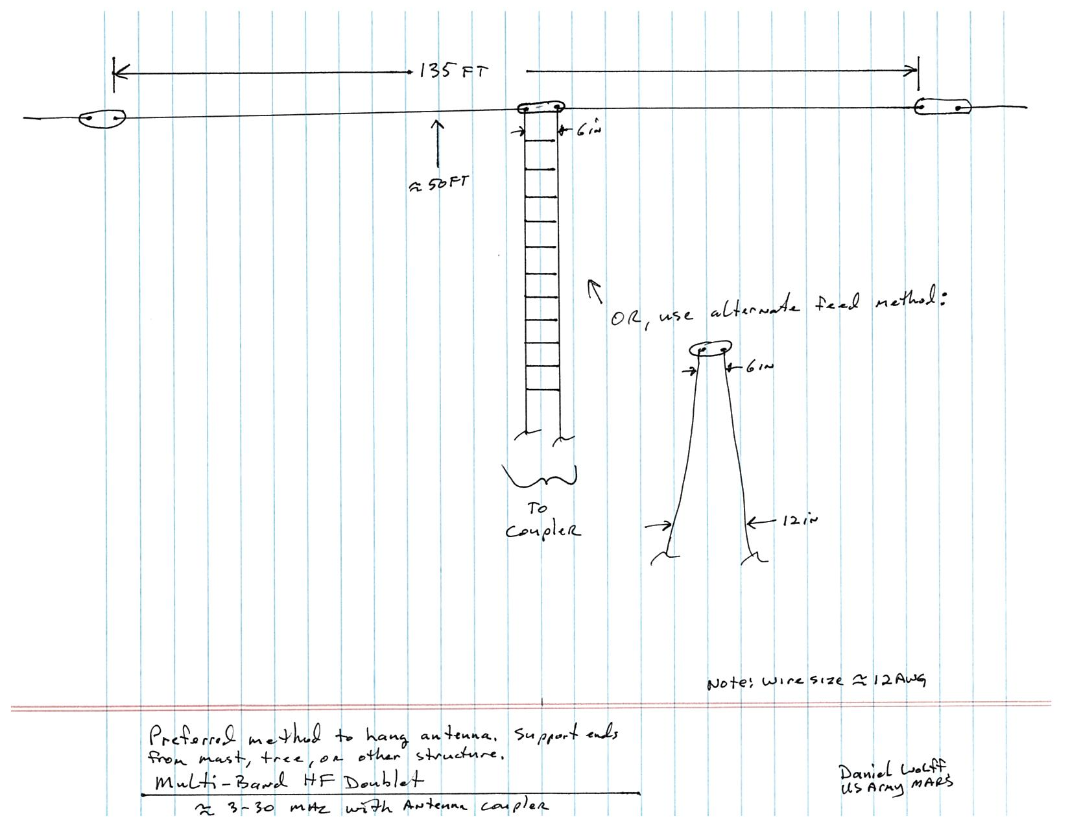

Slide 6
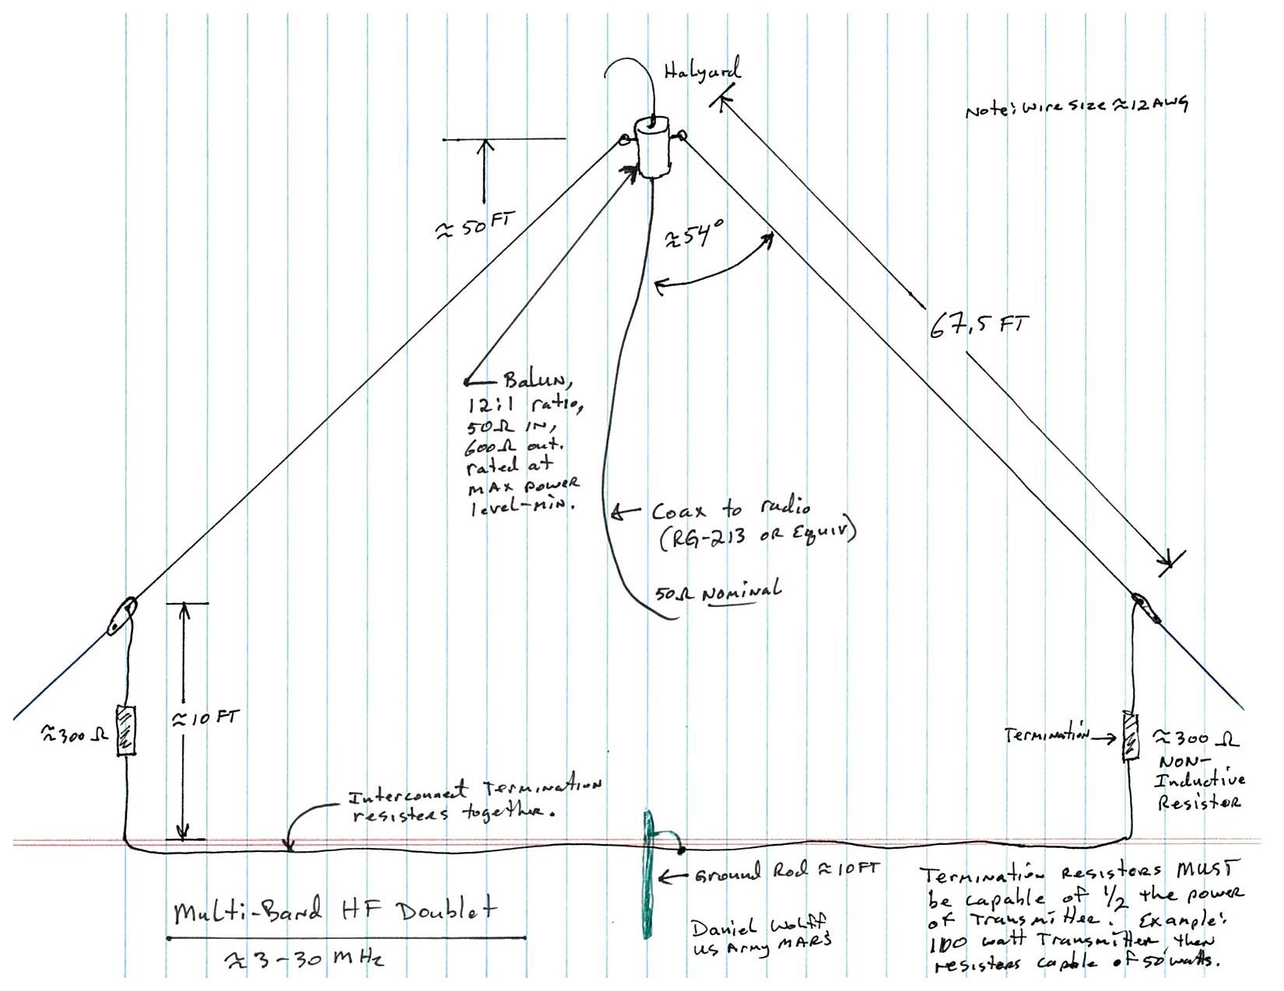

Slide 7
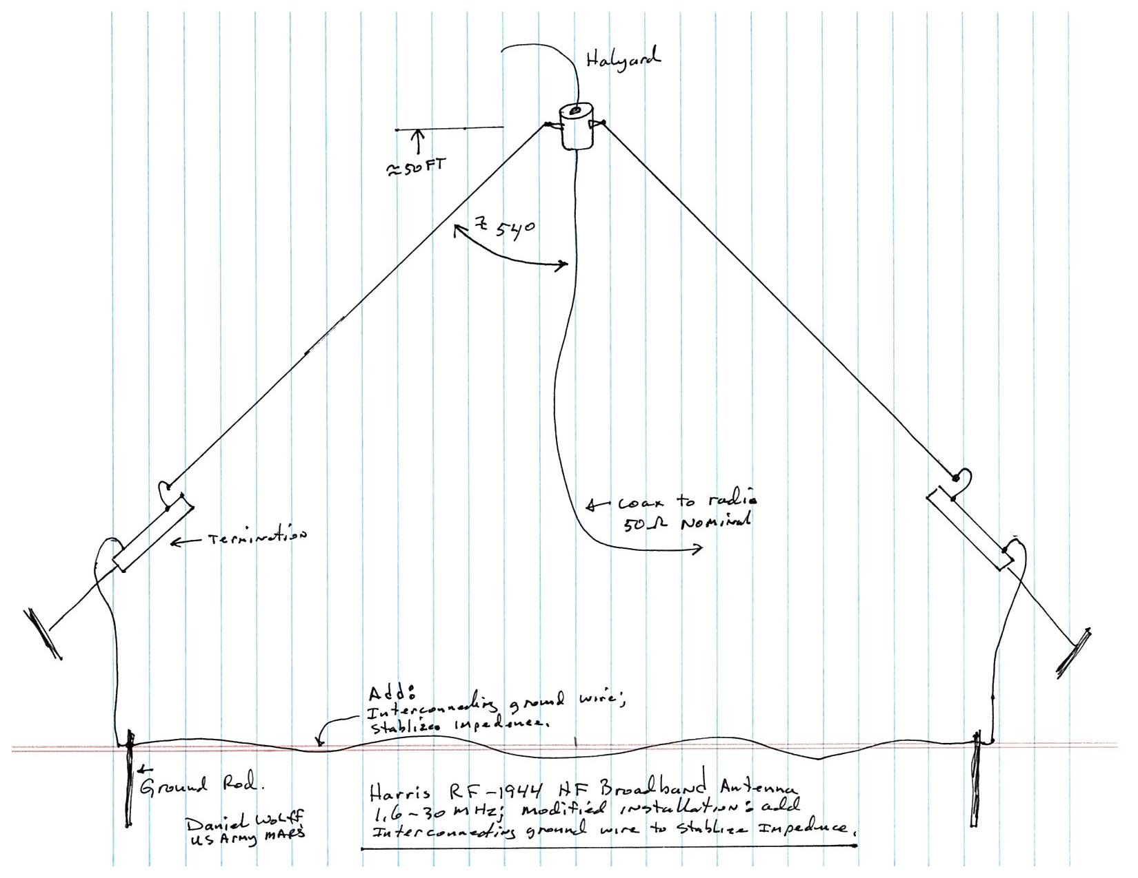

Slide 8
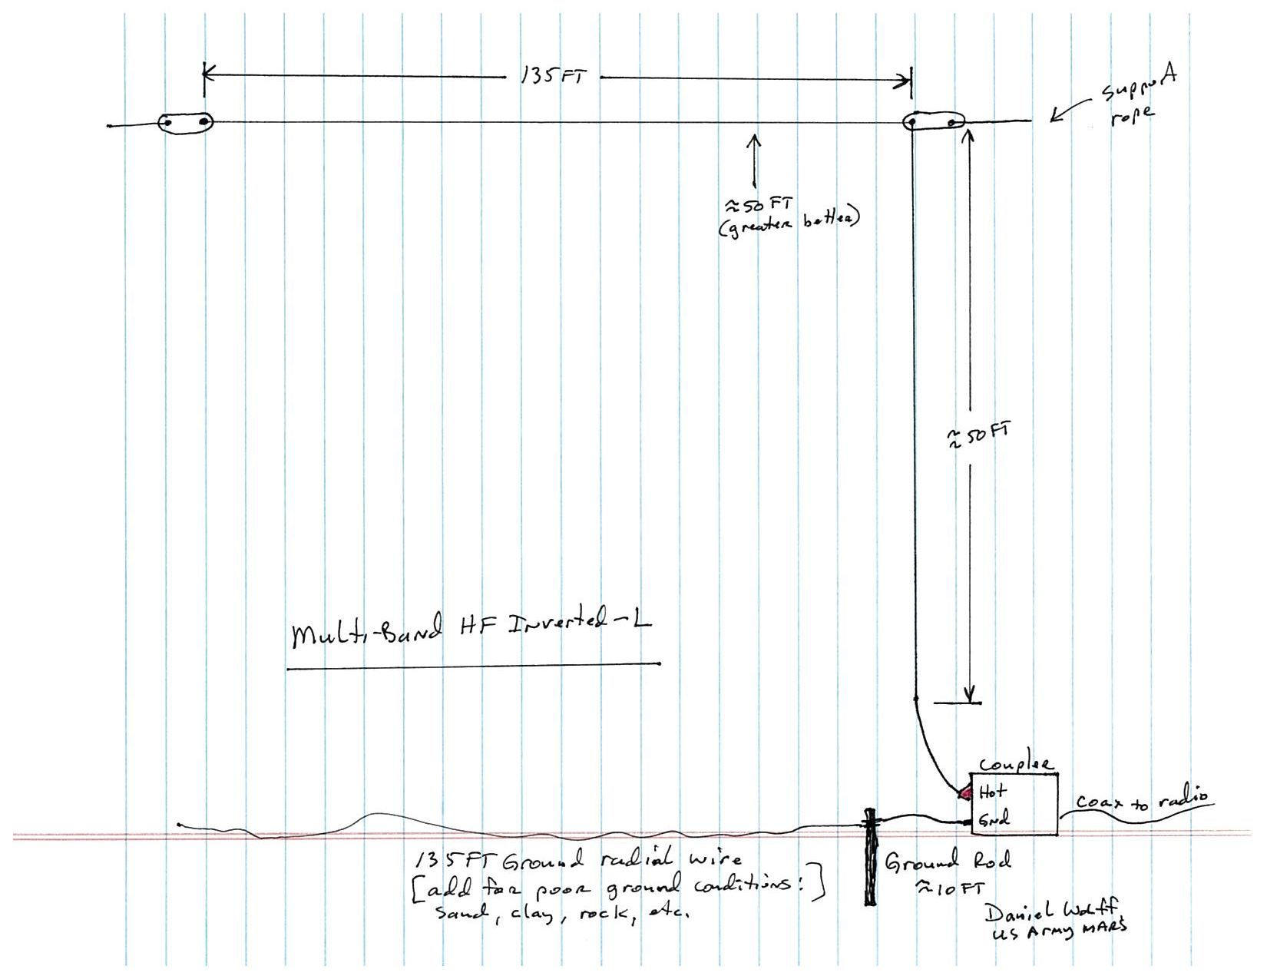

Slide 9
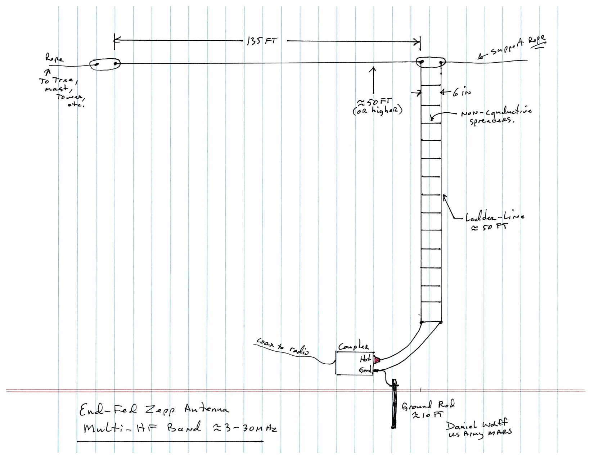

Slide 10
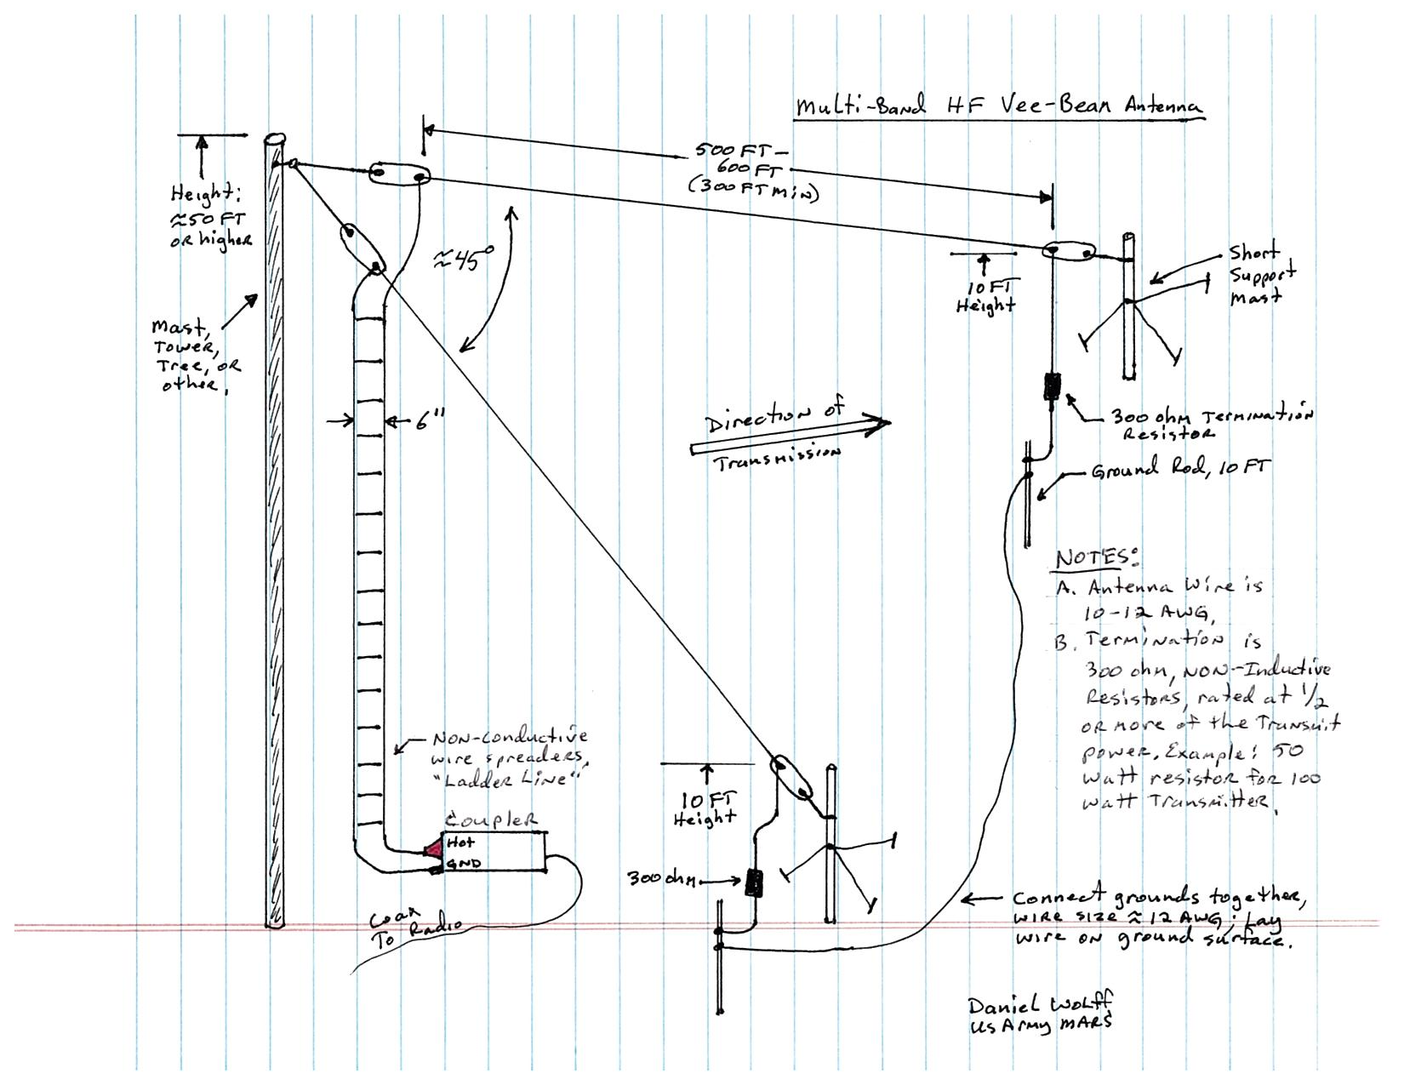

Slide 11
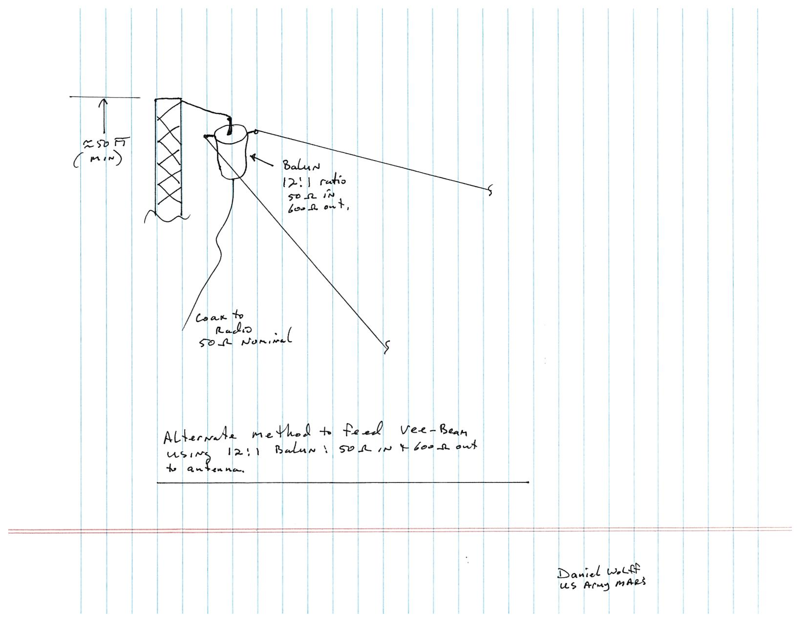

Slide 12
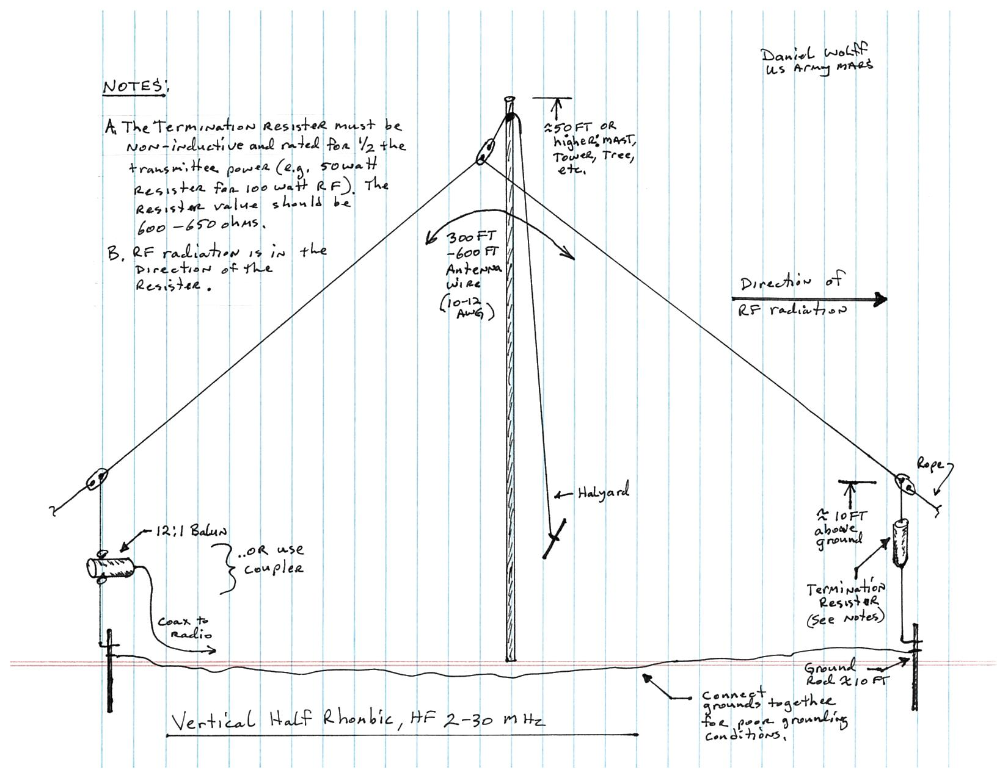

Slide 13
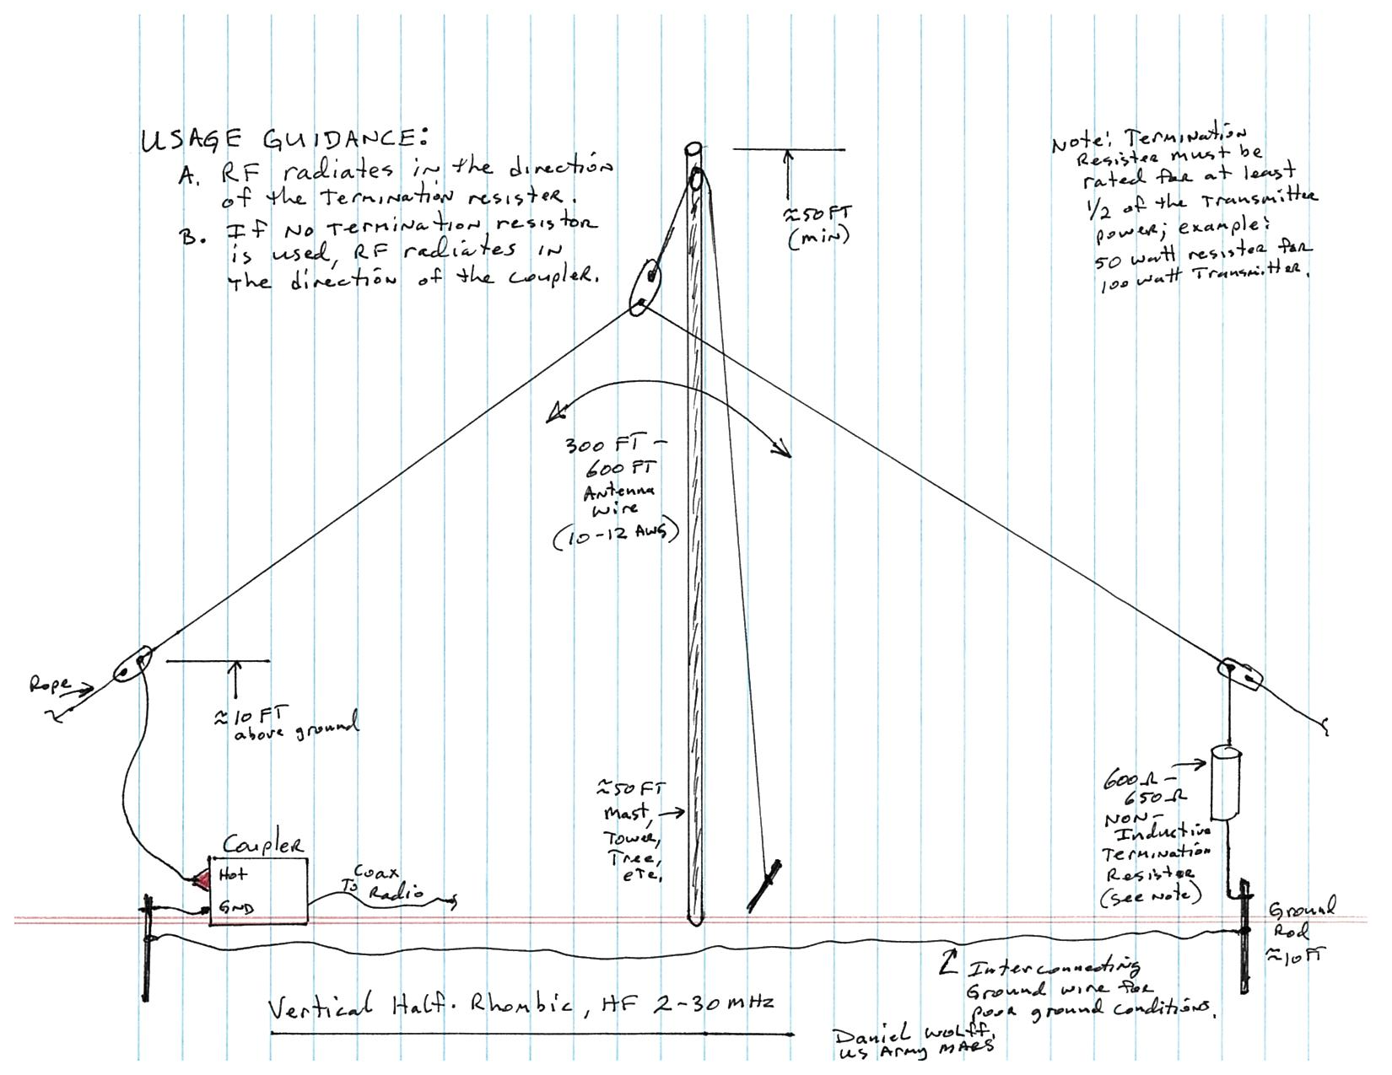

Slide 14
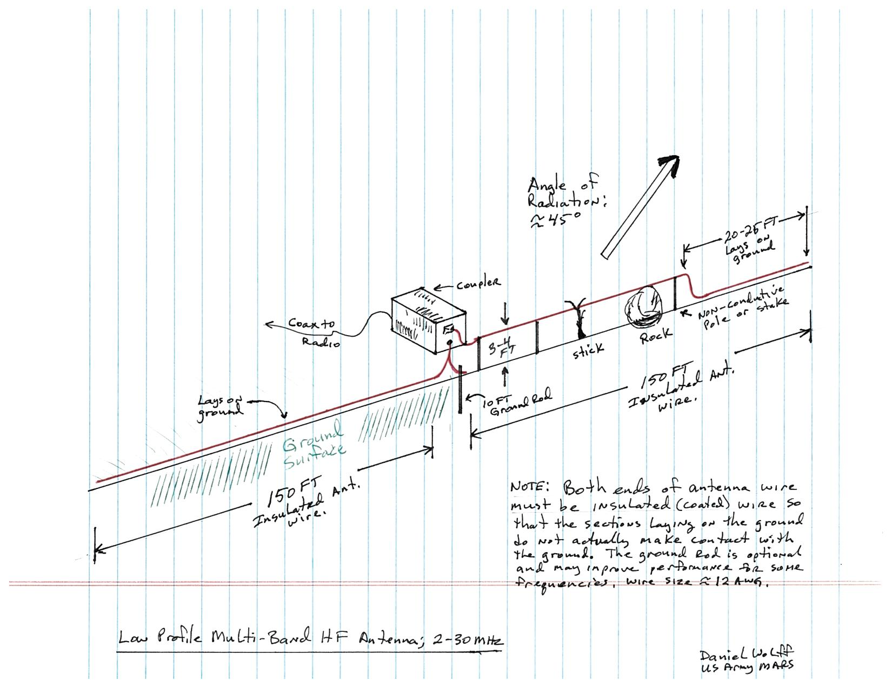

Slide 15
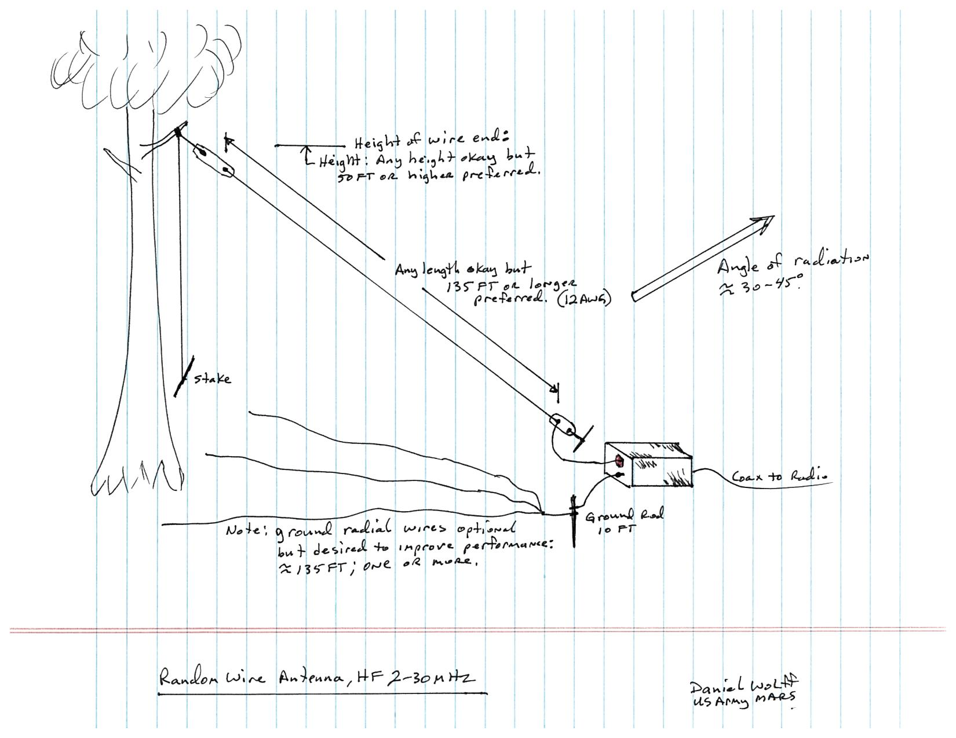

Slide 16
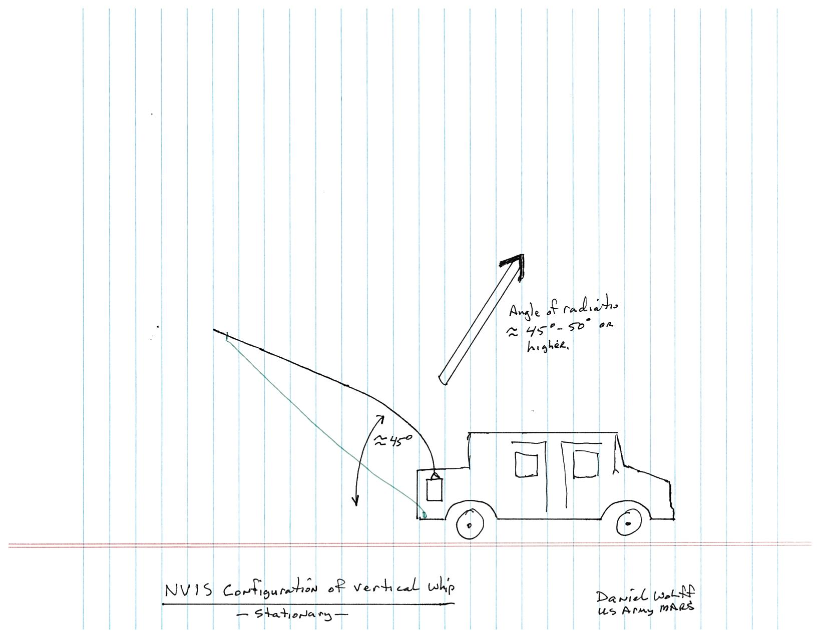

Slide 17
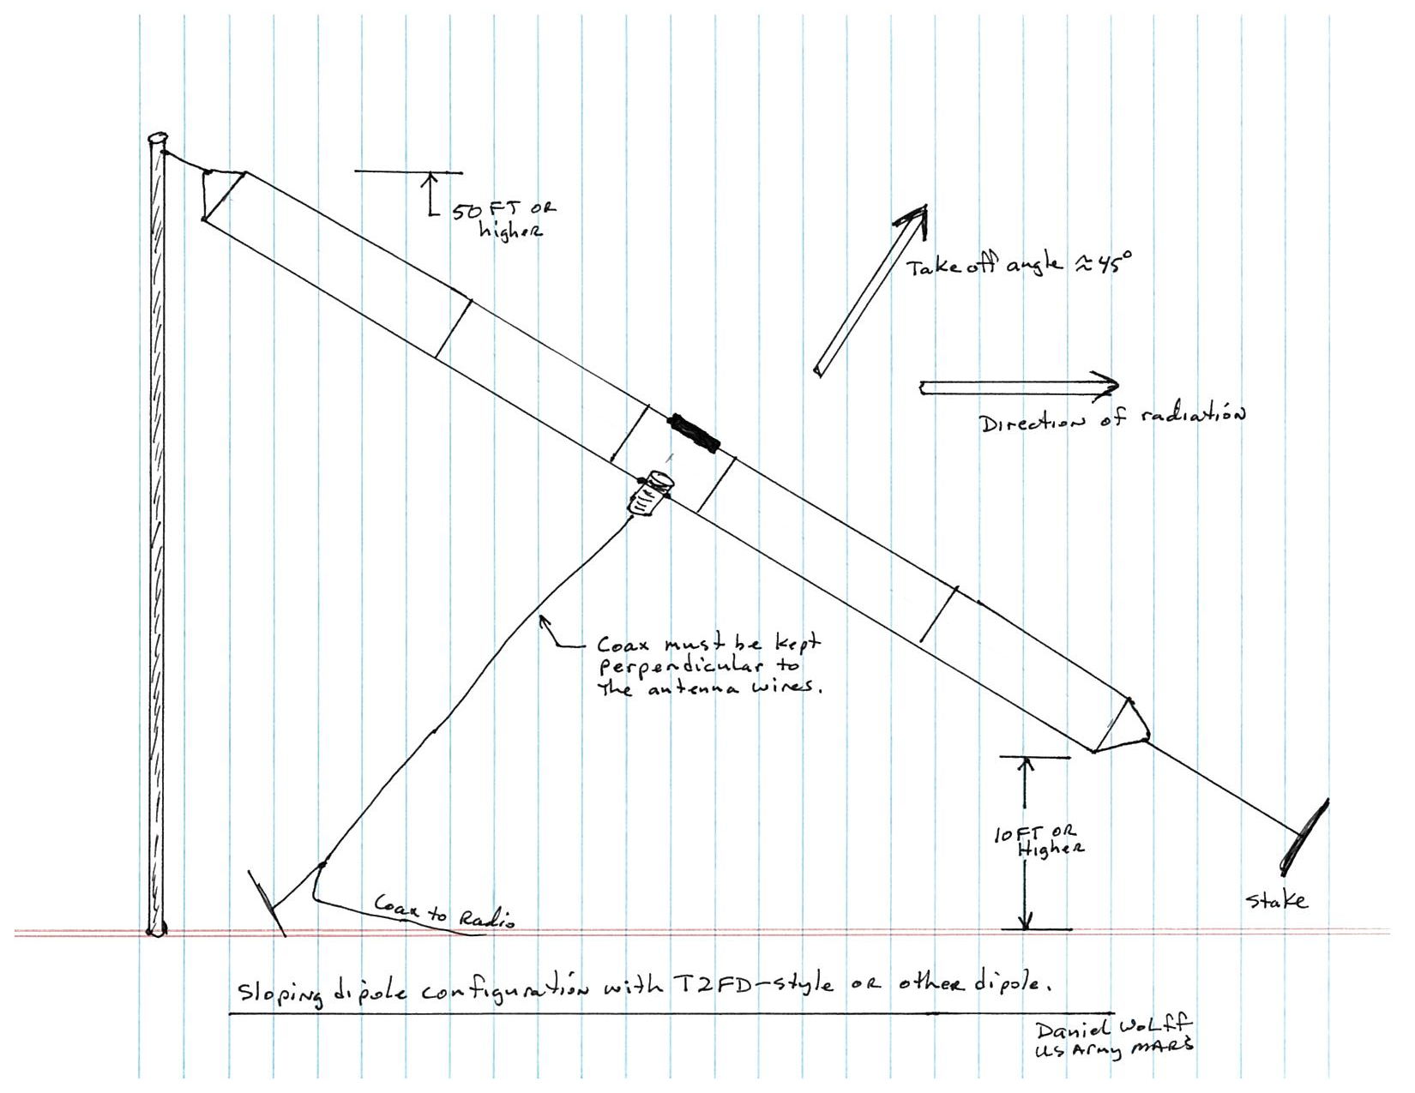

Slide 18
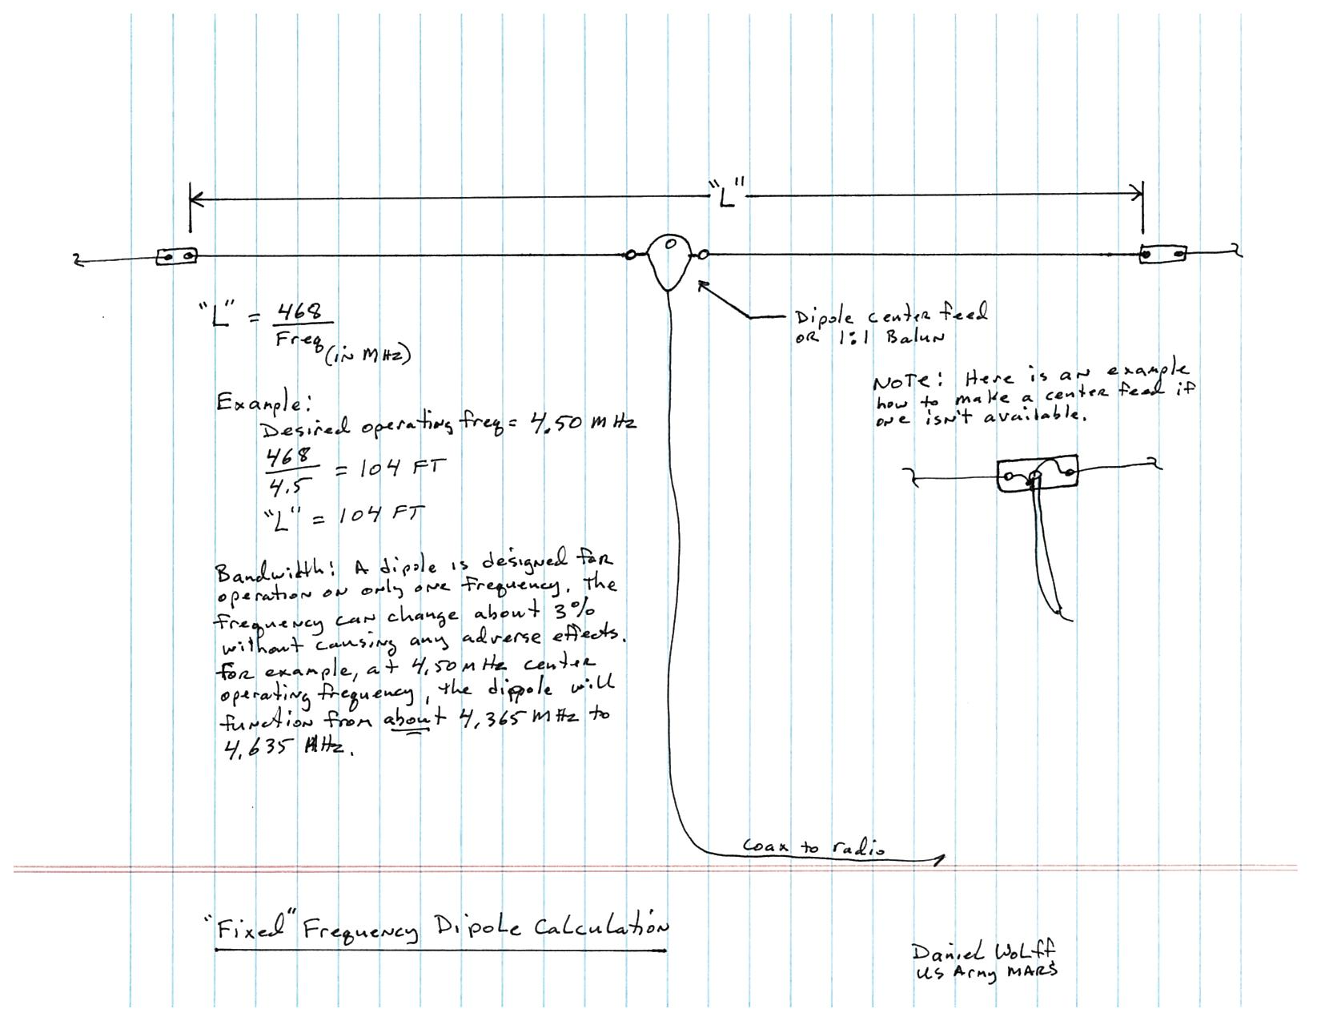

Slide 19
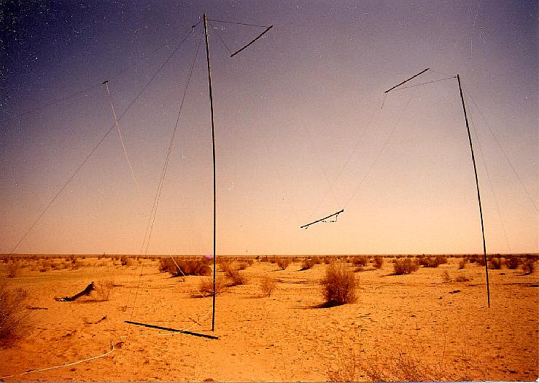
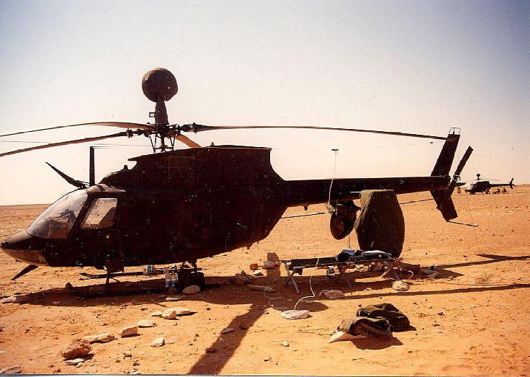
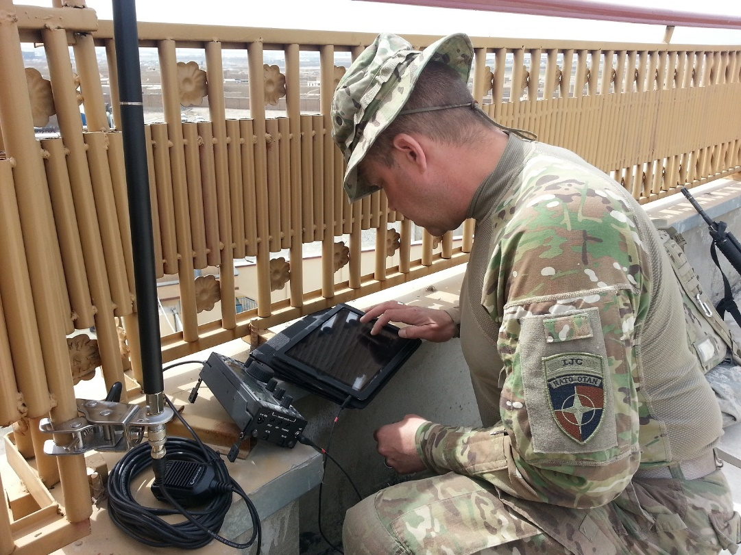
CONTACT US:
TOLL FREE: +1 (800) 633-1128
OFFICE: +1 (520) 538-7933
DSN: (312) 870-7933
US Army NETCOM/MARS
HQ, Army MARS Public Portal:
http://www.usarmymars.org/
Army MARS on Facebook:
https://www.facebook.com/HQArmyMARS
HQ, Army MARS Military Portal:
http://www.netcom.army.mil/mars
"Proud, Professional, and Ready"

